Slide 1

Notes:
Thank you for our Sponsor’s.
Thank you to Niels and the team - hard work behind the scenes.

Slide 2
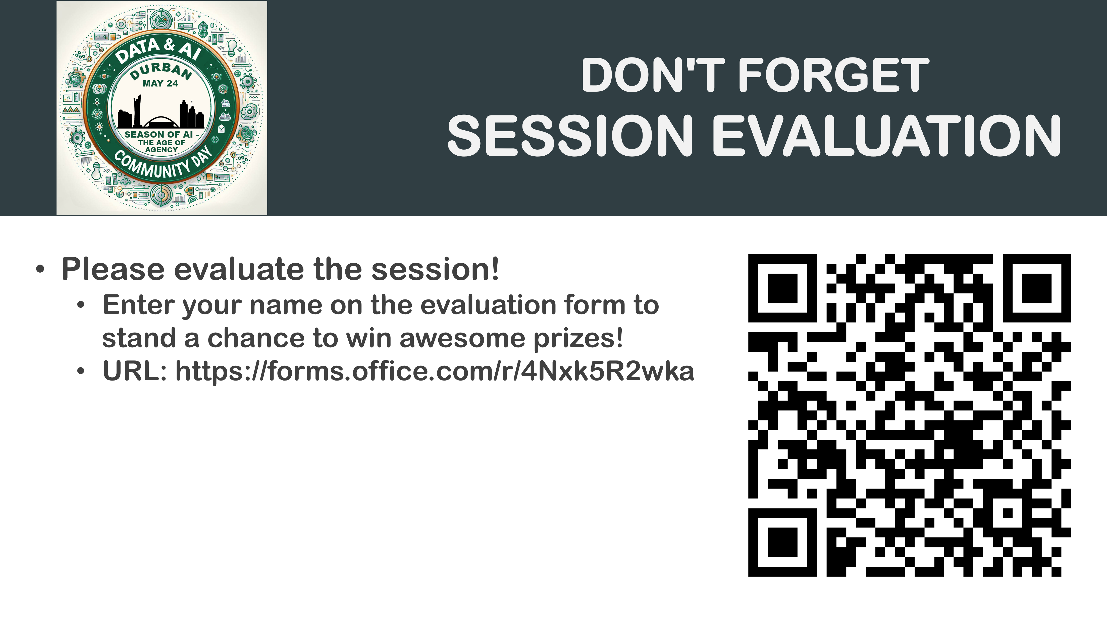

Slide 3
Who am I?
Education
Fun Facts
BCom (Financial Management)
BCIS (Computer Science)
In Progress - FTIP Certification
Musician: Writing & Producing
Debut EP in Progress
Passionate tea-quila lover
Open-Source Contributor
Notes:
Ground rule: If I don’t know something, I’ll honestly say I don’t know and will get back to you.

Slide 4
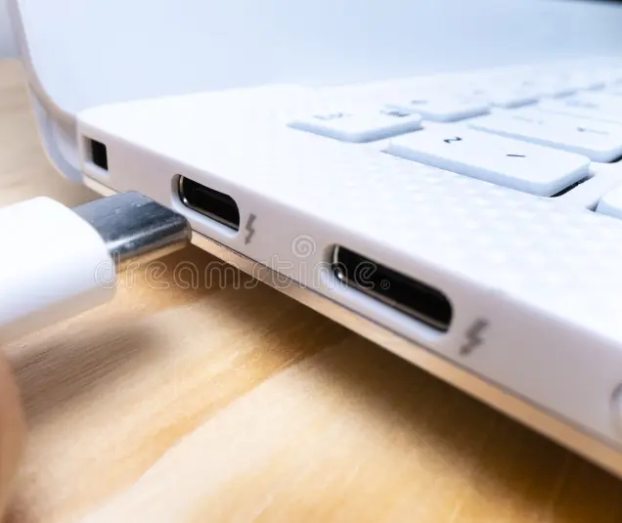
From APIs to MCP: AI Integration in Finance
Notes:
Ground rule: If I don’t know something, I’ll honestly say I don’t know and will get back to you.

Slide 5
Road Map
Why Integration Hurts?
01
What is Model Context Protocol (MCP)?
02
How can you use MContextodel Protocol (MCP)?
03

Slide 6
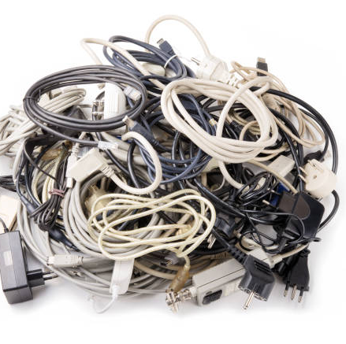
Why Integration Hurts?
Data locked in silos
Weeks-long onboarding
Patchwork fraud defenses
Notes:
Data silos block insight.
Weeks-long onboarding stalls customers and clients.
Fraud tools act too late.
Ask: “Who has felt this integration pain with API's?”

Slide 7

What is Model Context Protocol (MCP)?
One standard handshake. Any system.
Notes:
Think of the MCP, as a universal USB-C cable for AI.
Just like USB-C, it hides the ugly wiring and says, “Same plug, any device.”
One interface, fewer contracts, faster launches.

Slide 8
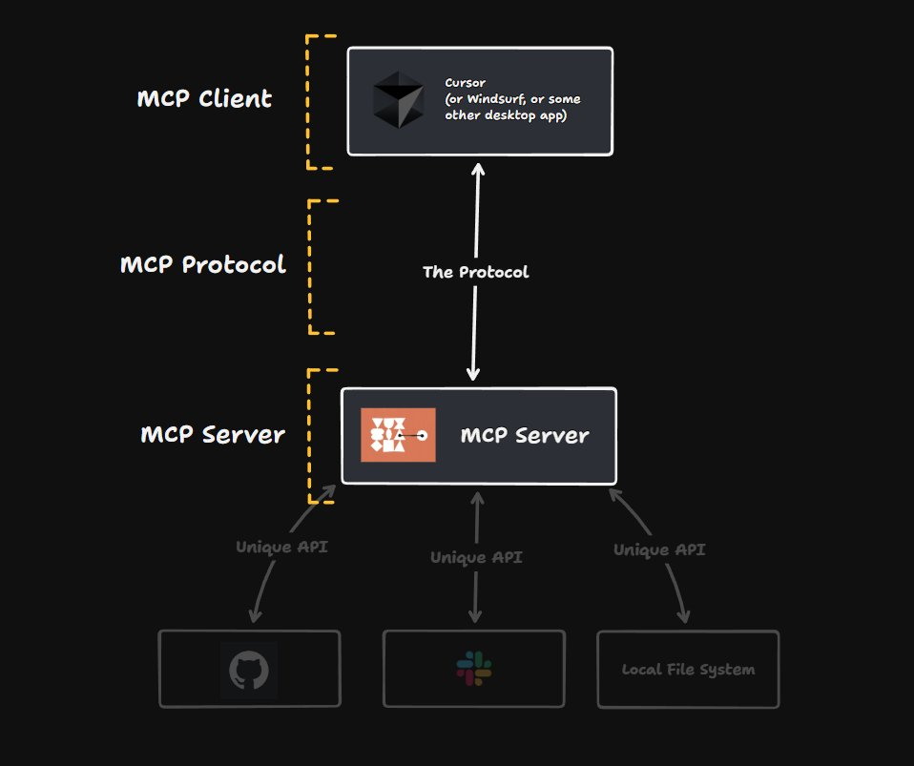
How Model Context Protocol (MCP) Works?
Map intents & data: MCP Client
Transform to model context: MCP Protocol
Deliver results back: MCP Server to MCP Client
Notes:
Map intents & data:
What job needs doing and where the right data lives.
Transform to model context
it packs that instruction into MCP’s common ‘plug’—almost like putting the right pins on the USB-C cable.
Deliver results back
Data comes straight back through the same port, and the agents translates it into a human answer, or fires off the next action.

Slide 9

Financial Institutions Wins
Real-time data exchange
Faster KYC (Know Your Customer) & onboarding
Live fraud & CX insights (Customer Experience Insights)
Notes:
Real-time data exchange:
FedNow’s rapid uptake. Less than two years after launch, more than 1 300 U.S. financial institutions are already live on FedNow.
Faster KYC (Know Your Customer) & onboarding:
Sardine reads a licence, checks selfie liveness, and returns a decision in < 20 seconds
Live fraud & CX insights (Customer Experience Insights):
Mastercard’s AI protects 159 B transactions annually and can lift fraud-catch rates by up to 300%

Slide 10
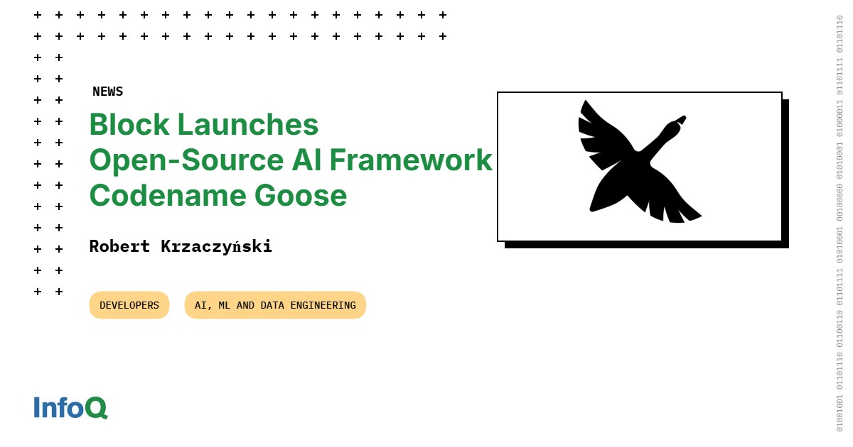
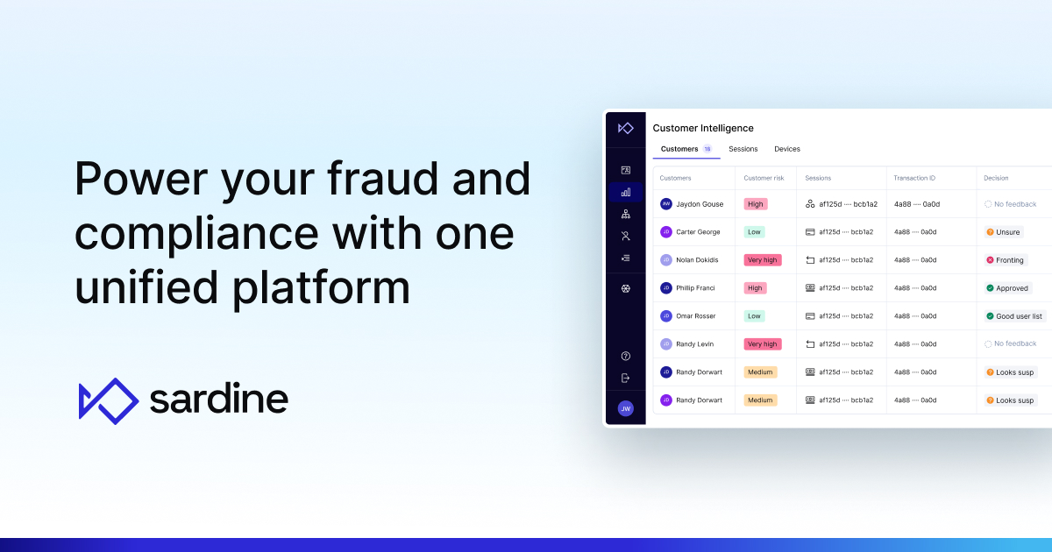
FinTech Innovation in the wild
Block’s goose agents plug into MCP for real-time action.
Sardine’s SDK unifies fraud via one API
Notes:
Block’s goose agents plug into MCP for real-time action.
Sardine’s SDK unifies fraud/KYC via one API.

Slide 11
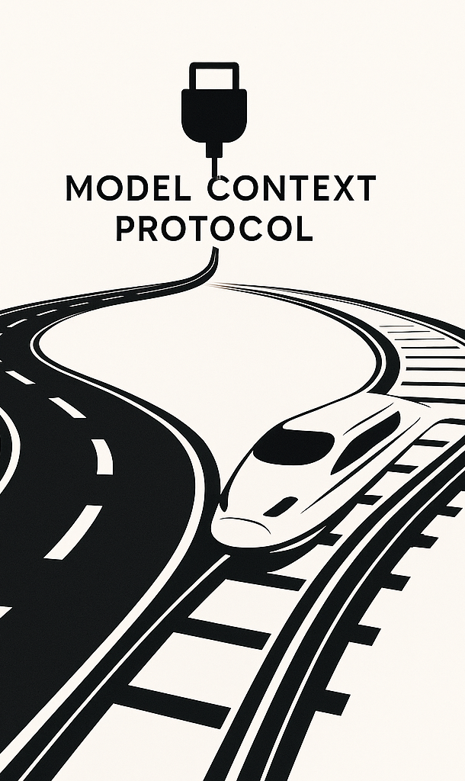
Unlocking new Opportunities
Today: Manual mapping, batch jobs, vendor lock-in.
Tomorrow: Plug-and-play models, real-time orchestration, ecosystem agility.
Notes:
Imagine rolling out a new product in less than a month.
Imagine rolling out a new AI feature in one week, not a month.
Imagine changing system prompts and custom prompts on the fly and not changing in production.

Slide 12
How to try it out today
AI Chat-Budgeting in Your Pocket.
AI-Assisted Tax Person.
AI Stock Screeners for investing.
Notes:
Copilot Money
H&R Block + OpenAI pilot
EasyEquities / Betterment

Slide 13
Key Takeaways
MCP = Universal AI Plug
3 moves: Map → Transform → Deliver
Real-time value - today

Slide 14

Questions, Ideas, Challenges?

Slide 16
Notes:
Again Thank you for our Sponsor’s

Slide 17
Thank You
Email: bevan.venter@yahoo.com
LinkedIn: https://www.linkedin.com/in/bevan-venter-3aabb4111/
GitHub: https://github.com/Yo-Yo-ZA

Slide 18
https://block.github.io/goose/
https://www.sardine.ai/platform
https://modelcontextprotocol.io/introduction
https://medium.com/vedcraft/unlocking-agentic-apps-with-the-model-context-protocol-mcp-for-financial-services-a-complete-3196cc455868
https://www.paymentsdive.com/news/fednow-draws-1300-financial-firms/746106/
https://www.chartis-research.com/custom-insights/7947225/keeping-good-company-streamlining-client-onboarding-with-cdi-part-1
https://www.businessinsider.com/sc/how-ai-at-scale-is-shaping-the-future-of-commerce

